Slide 1

AFRITECH ELECTRONICS LIMITED
Interactive Dashboard Summary & Strategic Recommendations

Slide 2
Aim & Objectives
Aim:
• Provide actionable insights using visual analytics to support strategic decisions.
Objectives:
• Identify key customer demographics and purchasing behavior.
• Monitor and improve product and regional sales performance.
• Evaluate brand sentiment and influencer effectiveness.
• Assess product recall and crisis response trends.

Slide 3
Key Insights by Dashboard
Customer Dashboard:
• Middle-income segment dominates; the 45–64 age group is most active.
• Rhode Island and Iowa lead in customer concentration.
Sales Dashboard:
• Tablet is the top-selling product ($11,009); slicer added for product filtering.
• West Virginia leads in revenue; Laptops cause major recall losses.
Brand Sentiment:
• TikTok highest engagement; Instagram top content effectiveness.
Crisis Management:
• Low resolution rate (8.66%); unresolved cases exceed 7,000.

Slide 4
Strategic Recommendations
• Strengthen product quality control, especially for Laptops.
• Expand engagement with the 25–44 age demographic.
• Improve the crisis response process to raise the resolution rate.
• Use TikTok and Instagram insights for targeted marketing.
• Monitor low-performing regions and products for intervention.

Slide 5
Appendices

Slide 6


Slide 7
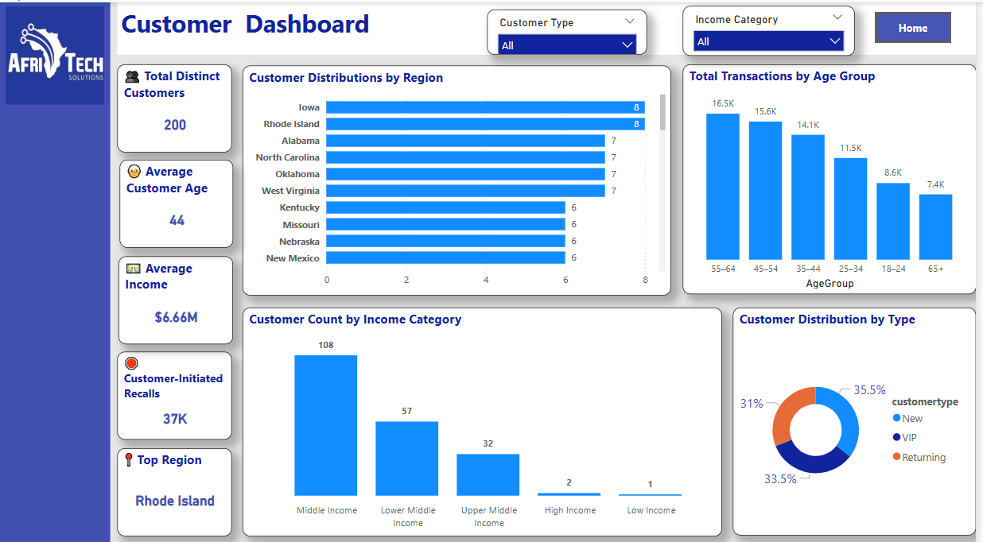

Slide 8
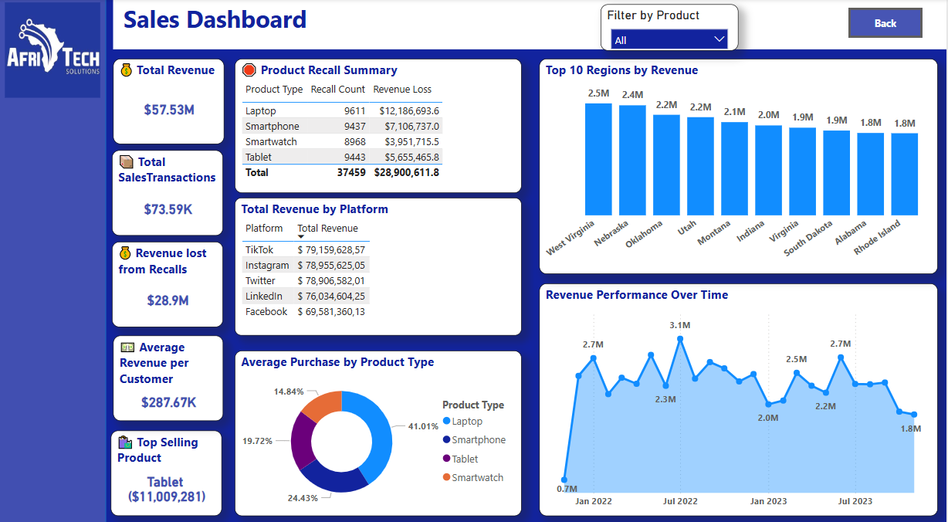

Slide 9
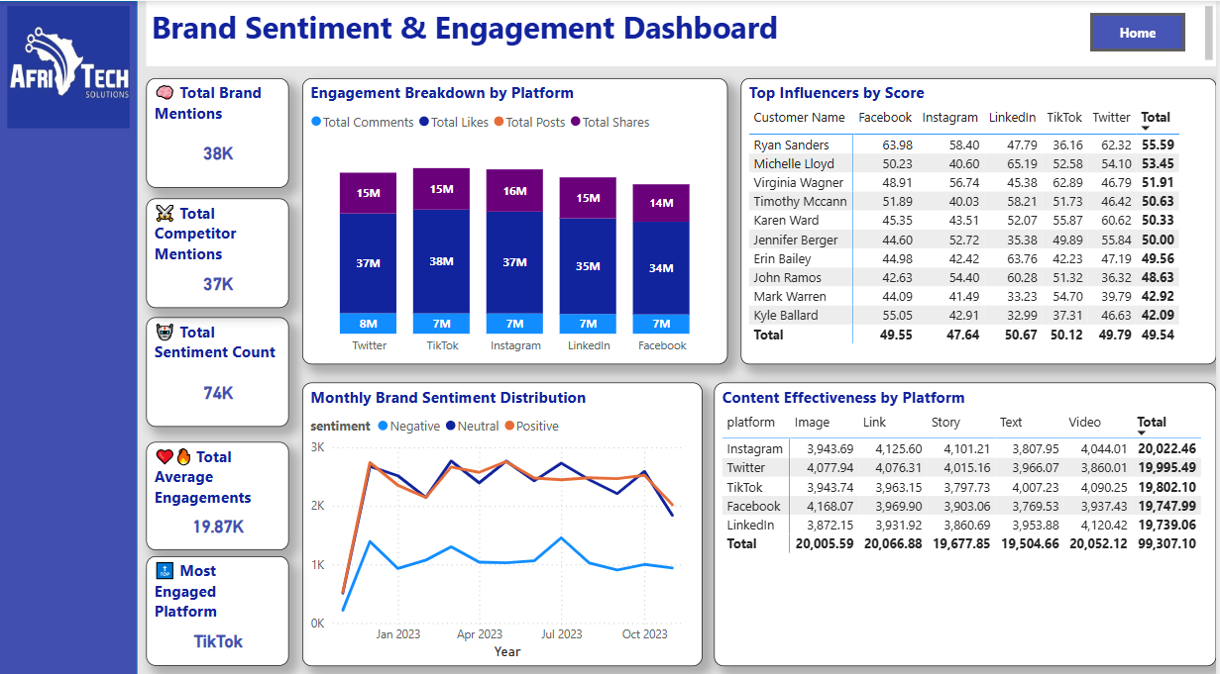

Slide 10
